Slide 1

Regression Models and Linear Prediction
Payam Barnaghi
Department of Brain Sciences &
School of Convergence Science in Human and Artificial Intelligence
Imperial College London
January 2025
Notes:
1

Slide 2
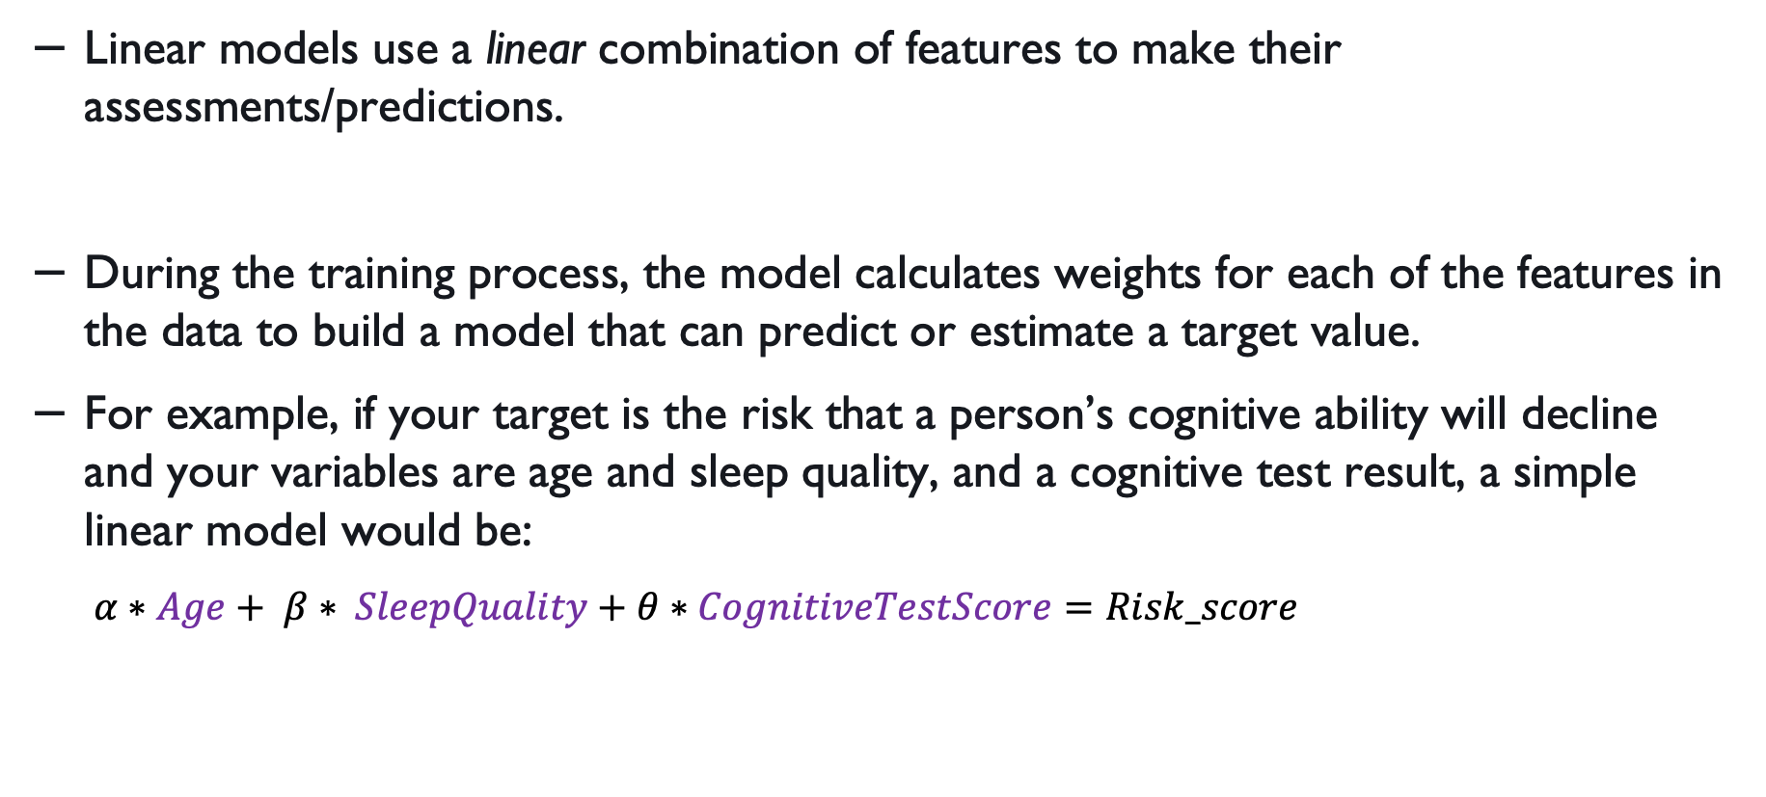
Linear models
Linear models use a linear combination of features to make their assessments/predictions.
During the training process, the model calculates weights for each of the features in the data to build a model that can predict or estimate a target value.
For example, if your target is the risk that a person’s cognitive ability will decline and your variables are age and sleep quality, and a cognitive test result, a simple linear model would be:
$α∗Age+ β∗ SleepQuality+θ∗CognitiveTestScore=Risk_score$

Slide 3
Linear models: example

Slide 4
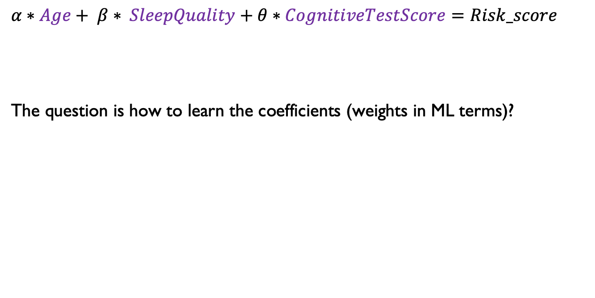
Linear models - training
$α∗Age+ β∗ SleepQuality+θ∗CognitiveTestScore=Risk_score$
The question is how to learn the coefficients (weights in ML terms)?

Slide 5
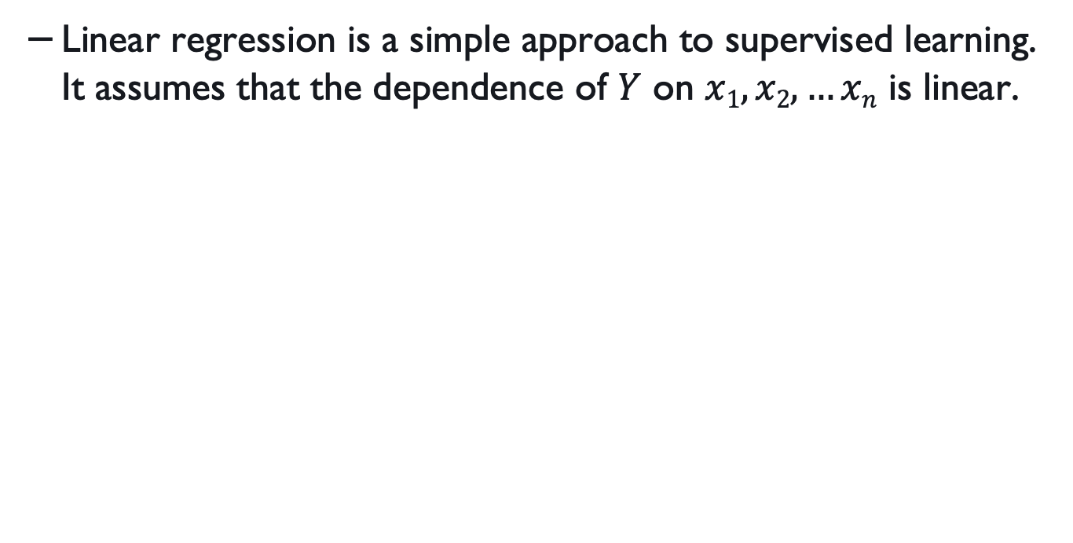
Linear regression
Linear regression is a simple approach to supervised learning. It assumes that the dependence of $Y$ on $x1, x2,…xn$ is linear.

Slide 6
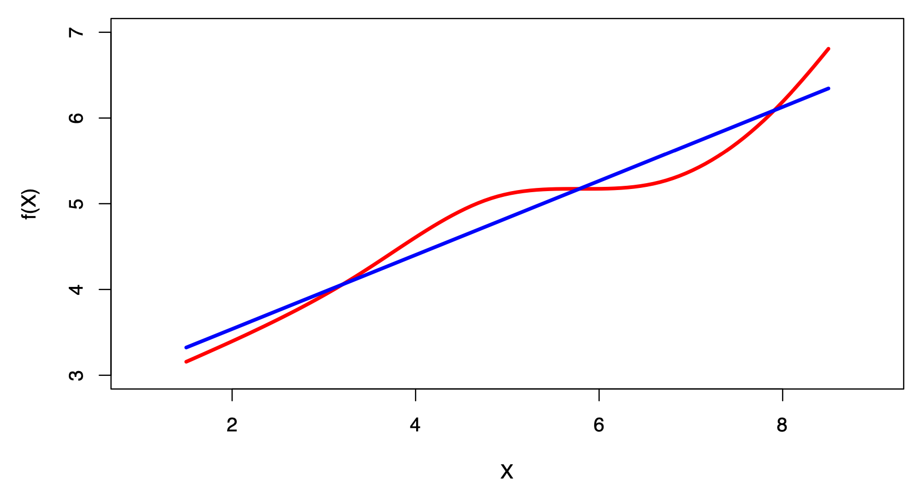
Linear regression and non-linear functions
Learning the weights in linear regression is a type of supervised learning.
It assumes that the target (often shown as Y) is dependent on the features.
True regression functions are never linear!
Figure source: Tibshirani et al., An introduction to statistical learning, Springer,: https://www.statlearning.com

Slide 7
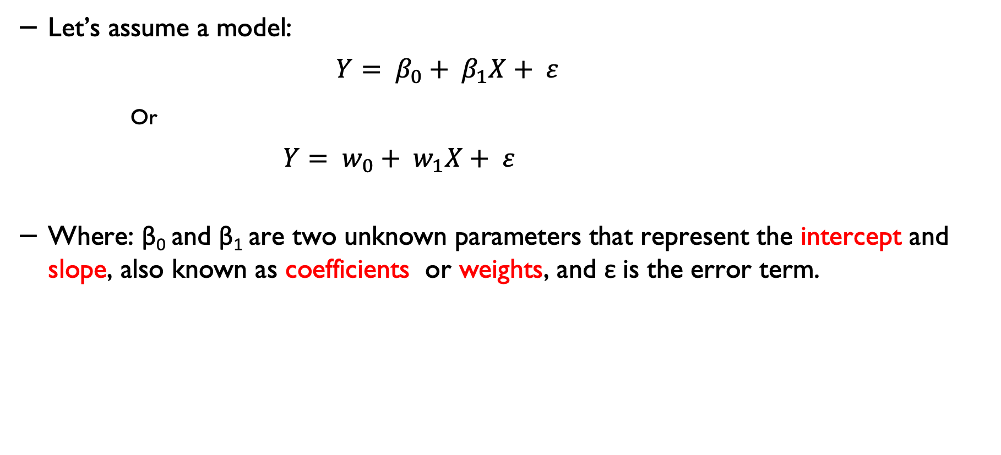
The terminology in linear regression
Let’s assume a model:
$$Y= β_{0}+ β_{1}X+ ε$$
Or
$$Y= w_{0}+ w_{1}X+ ε$$
Where: β₀ and β₁ are two unknown parameters that represent the intercept and slope, also known as coefficients or weights, and ε is the error term.

Slide 8
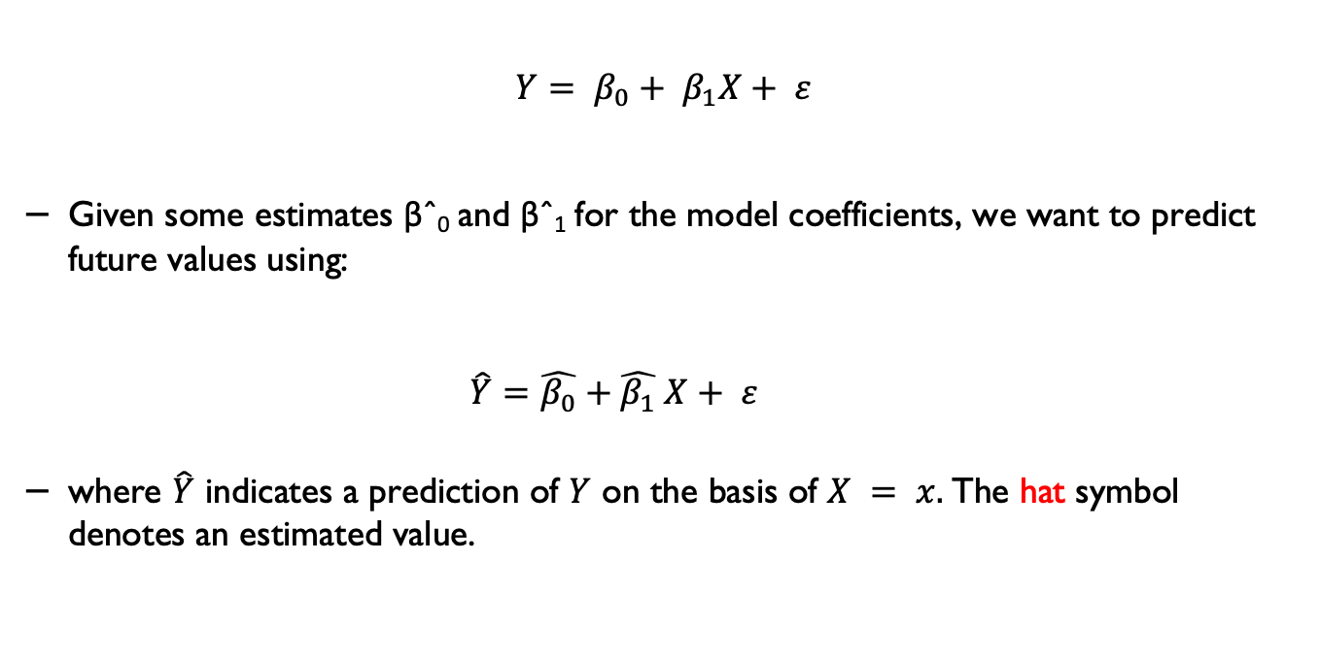
Simple linear regression using a single predictor
$$Y= β_{0}+ β_{1}X+ ε$$
Given some estimates βˆ₀ and βˆ₁ for the model coefficients, we want to predict future values using:
$\hat{Y}=\hat{β_{0}}+\hat{β_{1}} X+ ε$
where $\hat{Y}$ indicates a prediction of $Y$ on the basis of $X = x.$The hat symbol denotes an estimated value.

Slide 9
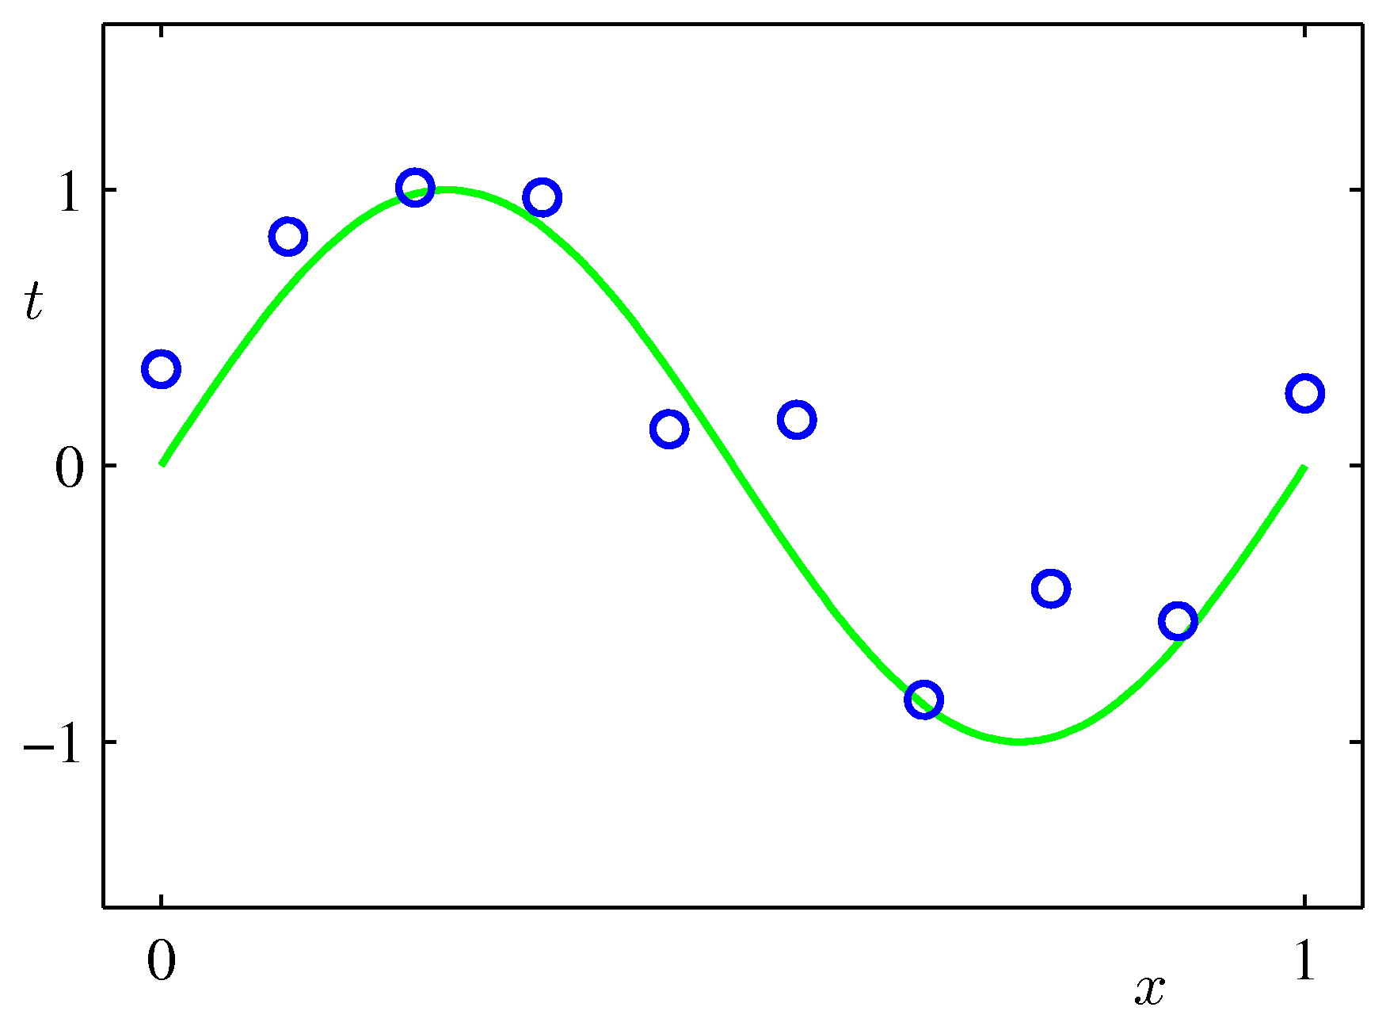
Liner regression and parameters
Figure source: Tibshirani et al., An introduction to statistical learning, Springer,: https://www.statlearning.com

Slide 10
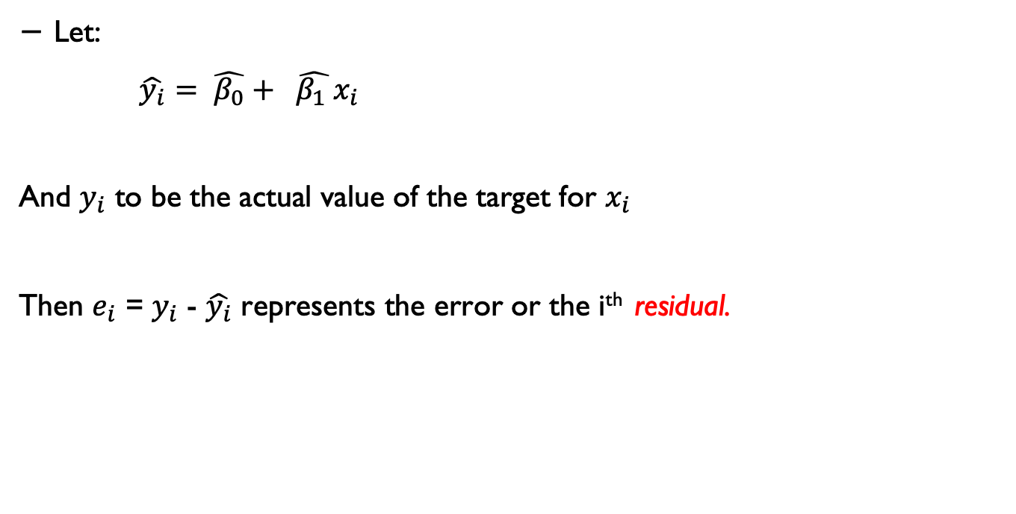
Estimating the parameters
Let:
$\hat{y_{i}}= \hat{β_{0}}+ \hat{β_{1} }x_{i}$
And $y_{i}$ to be the actual value of the target for $x_{i}$
Then $e_{i}$ = $y_{i}$ - $\hat{y_{i}}$ represents the error or the i^{th} residual.

Slide 11
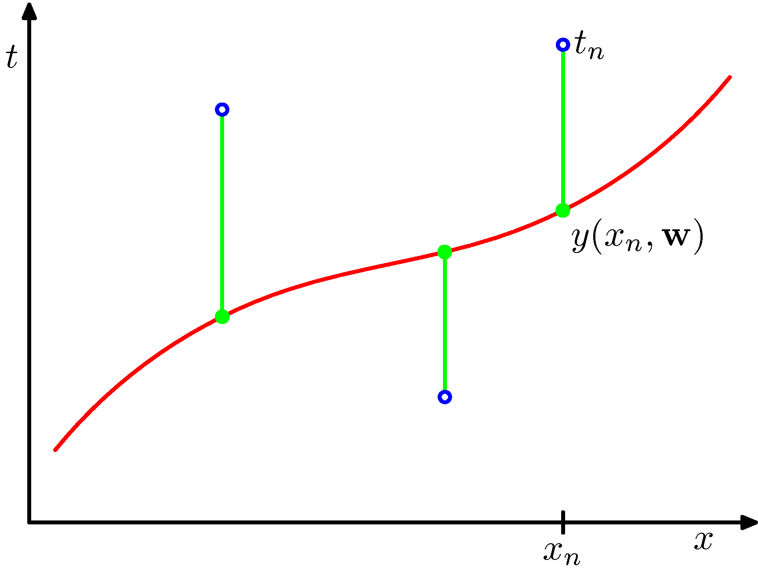
Residual
Source: : Tibshirani et al., An introduction to statistical learning, Springer,: https://www.statlearning.com

Slide 12
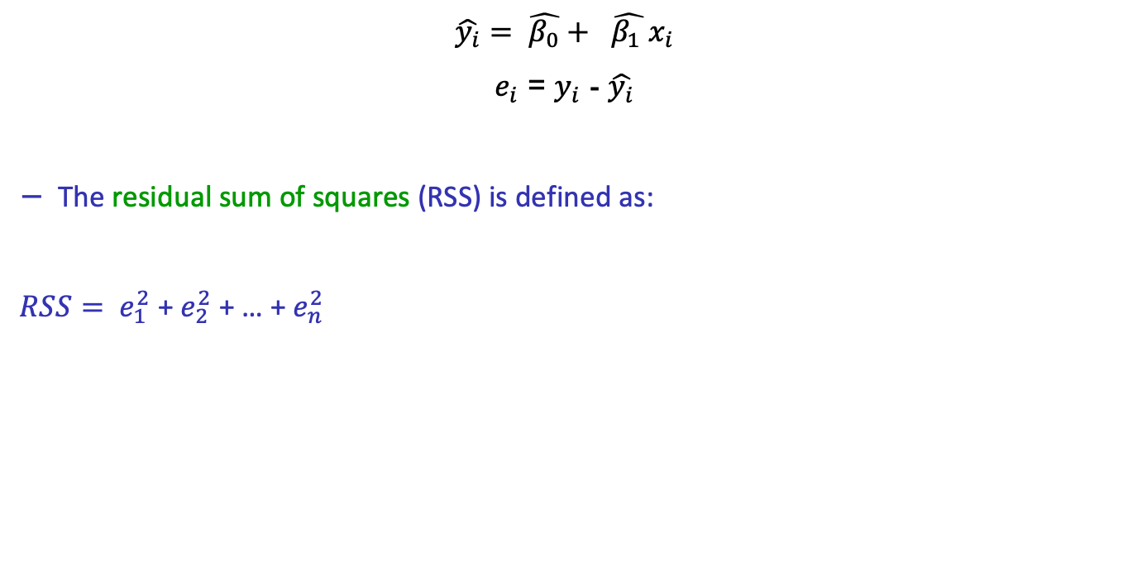
Estimating the parameters
$$\hat{y_{i}}= \hat{β_{0}}+ \hat{β_{1} }x_{i}$$
$e_{i}$ = $y_{i}$ - $\hat{y_{i}}$
The residual sum of squares (RSS) is defined as:
$RSS= e_{1}^{2}$ + $e_{2}^{2}$ + … + $e_{n}^{2}$

Slide 13
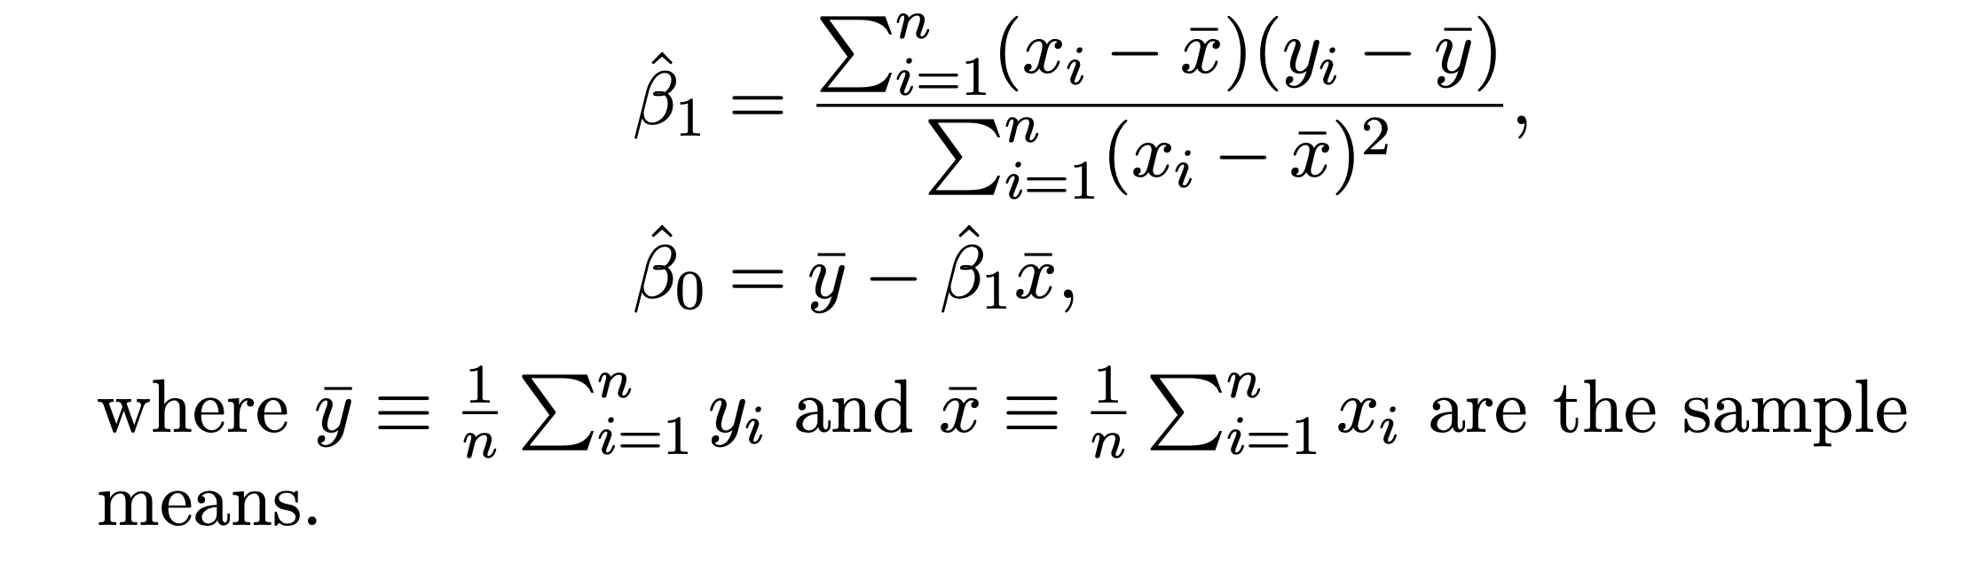
Estimating the parameters*
The least squares approach chooses βˆ₀ and βˆ₁ to minimise the RSS.
The minimising values can be shown to be
*Note: When you see this star sign (*) on the slides, you can skip it if you are not interested in the detailed mathematical background. This information is provided as an additional background and will not be part of the module assessment, and you are not expected to know them.
Source: Tibshirani et al., An introduction to statistical learning, Springer,: https://www.statlearning.com

Slide 14
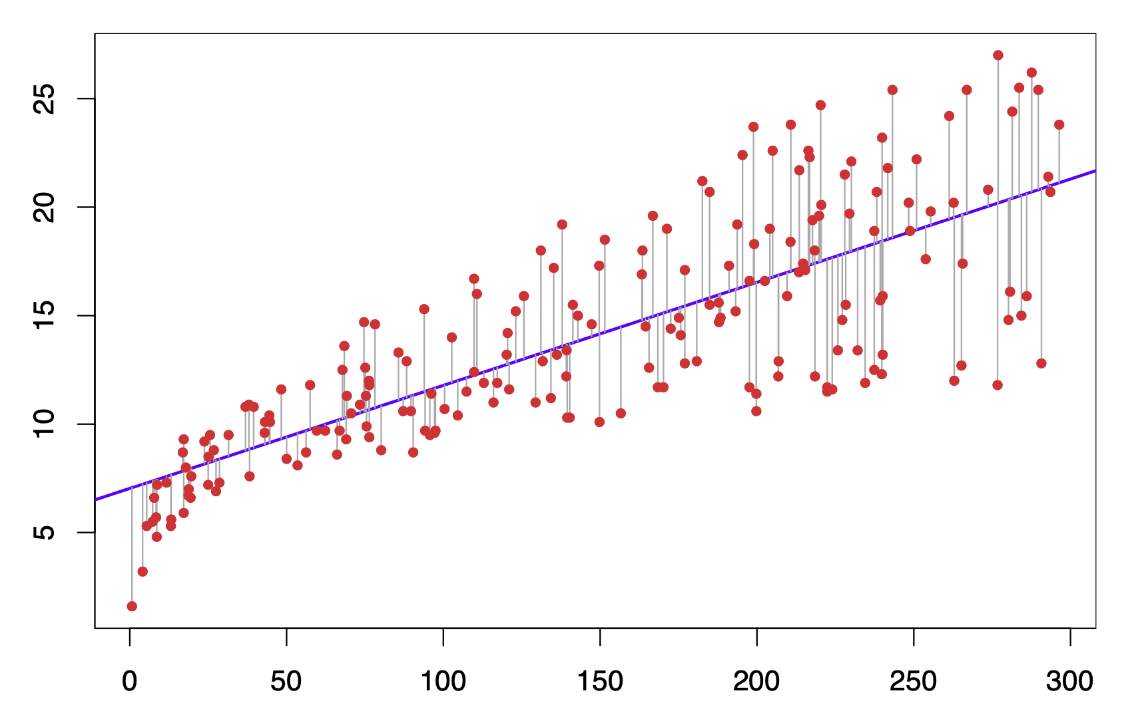
Estimating the parameters in a simple regression
Figure source: Tibshirani et al., An introduction to statistical learning, Springer,: https://www.statlearning.com

Slide 15
Source: Nagesh Singh Chauhan, KDnuggets https://www.kdnuggets.com/2019/03/beginners-guide-linear-regression-python-scikit-learn.html

Slide 16
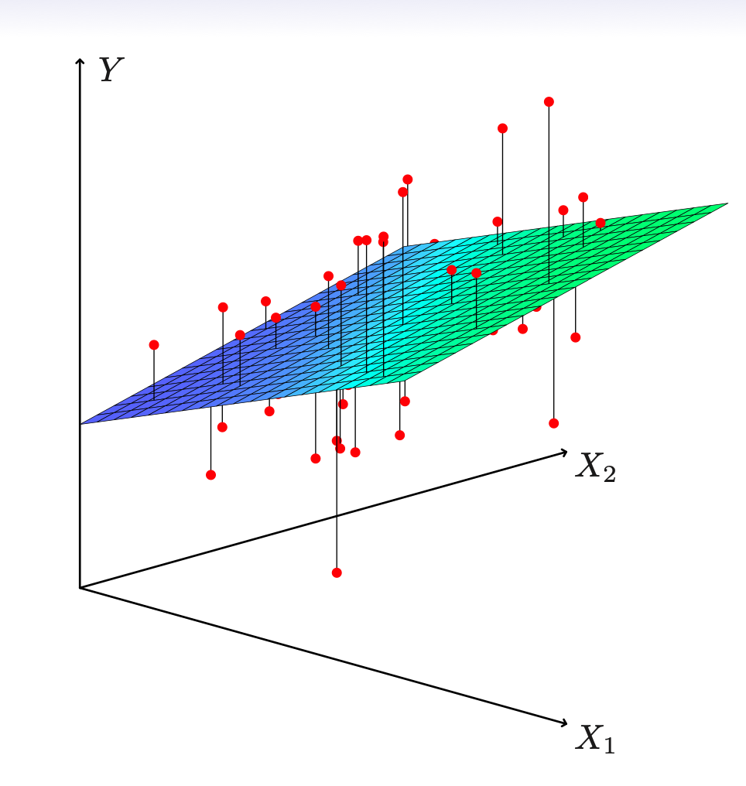
Estimation and prediction for multiple regression

Slide 17

Defining linear regression - again
A Linear Regression model uses a linear model with coefficients $w = (w1, …, wn)$ to minimise the residual sum of squares between the observed targets in the dataset and the targets that are predicted by the linear approximation used in the model.

Slide 18

Sequential learning – Stochastic Gradient Descent*
The input data is considered one at a time.
We can use stochastic (sequential) gradient descent to learn the parameters of a multiparameter regression:
This is also known as the least-mean-squares (LMS) algorithm.
More on this topic later – in the neural networks section.

Slide 19
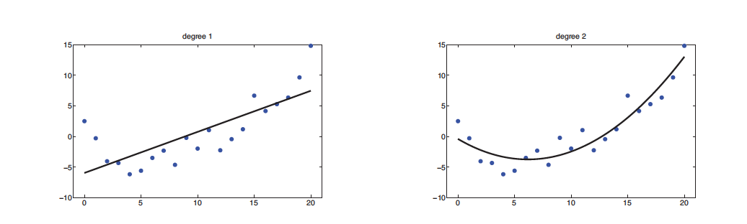
Obviously, the solution is not always a line
(a) Linear regression on some 1d data.
(b) Data with polynomial regression (degree 2).
Figure source: Tibshirani et al., An introduction to statistical learning, Springer,: https://www.statlearning.com

Slide 20
Type of problems that we can apply to
Predict the change in Neuropsychiatric Inventory (NPI) scores in people living with dementia as a function of a number of different clinical measurements and/or in-home observations.
e.g., https://pubmed.ncbi.nlm.nih.gov/22531424/
Predicting the functional consequences after TBI as a function of TBI severity, more prominent CT abnormality, past psychiatric history and alcohol intoxication.
e.g., https://pubmed.ncbi.nlm.nih.gov/34711118/

Slide 21
How to evaluate your LR model
Mean Absolute Error (MAE)
Mean Squared Error (MSE)
Root Mean Squared Error (RMSE)

Slide 22
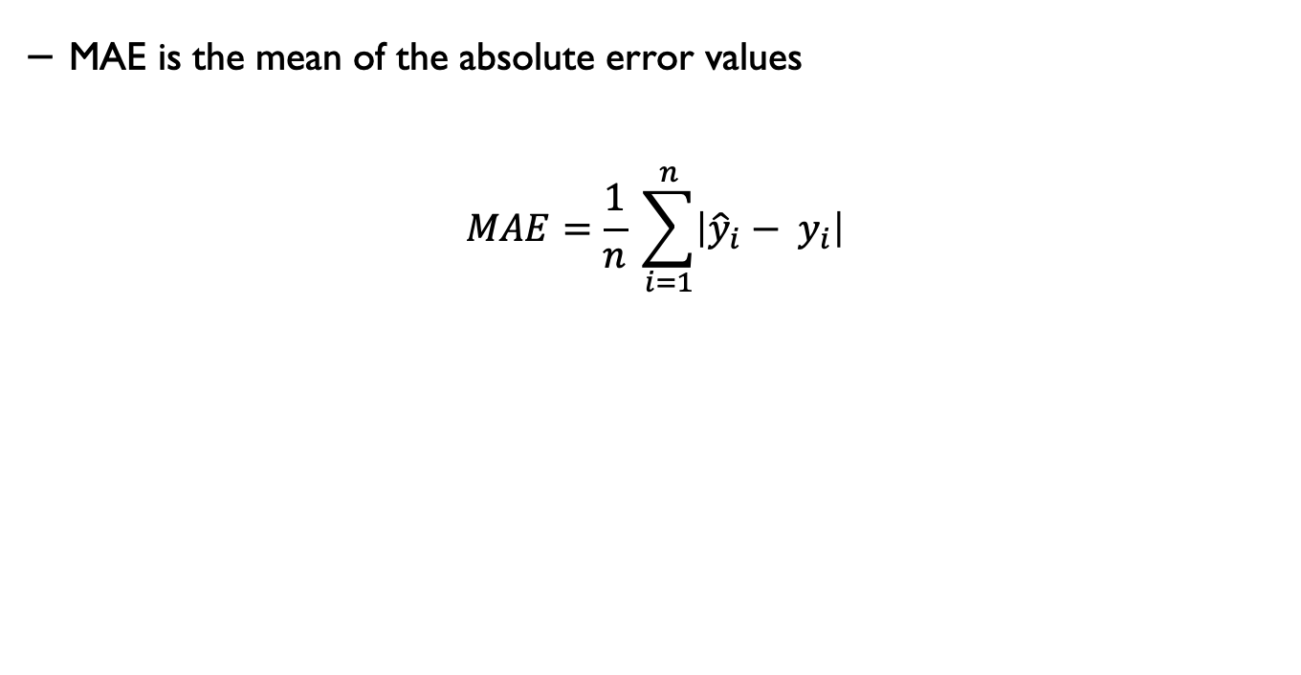
Mean Absolute Error (MAE)
MAE is the mean of the absolute error values
$$MAE=\frac{1}{n} \sum_{i=1}^{n}{\left|{\hat{y}}_{i}− y_{i}\right|}$$

Slide 23
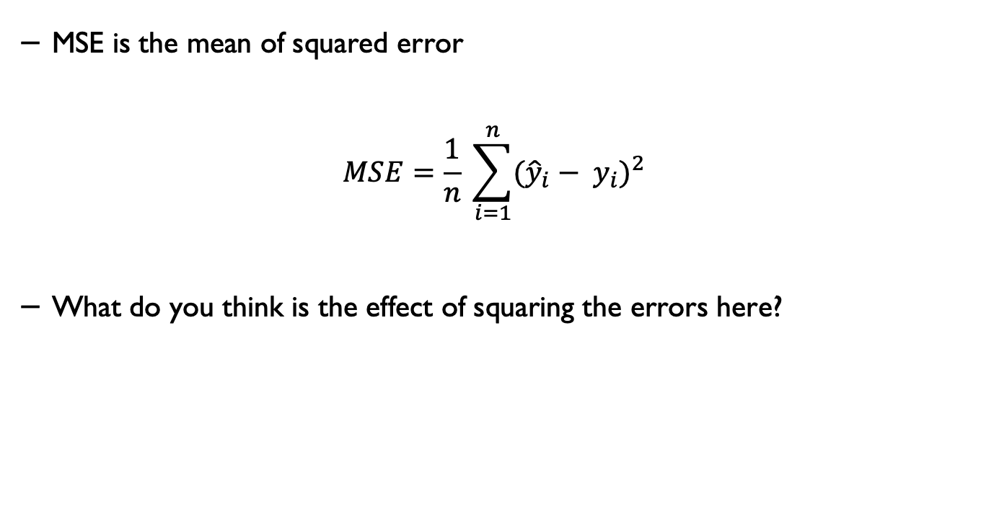
Mean Squared Error (MSE)
MSE is the mean of squared error
$$MSE=\frac{1}{n} \sum_{i=1}^{n}{{({\hat{y}}_{i}− y_{i})}^{2}}$$
What do you think is the effect of squaring the errors here?

Slide 24
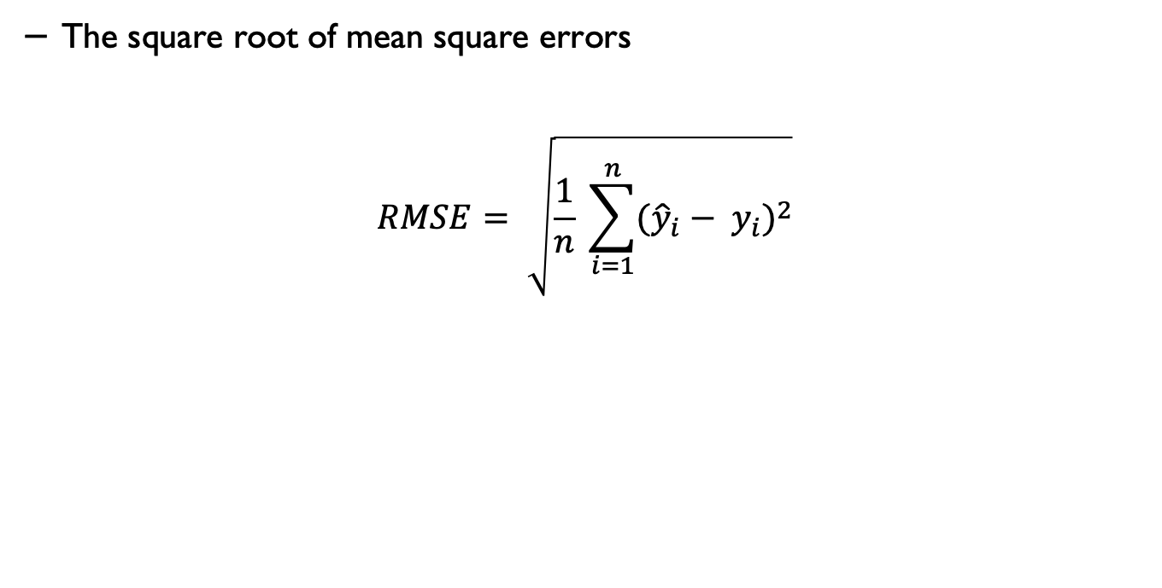
Root Mean Squared Error (RMSE)
The square root of mean square errors
$$RMSE= \sqrt{\frac{1}{n} \sum_{i=1}^{n}{{({\hat{y}}_{i}− y_{i})}^{2}}}$$

Slide 25
Mean Squared Error (MSE) and Root Mean Squared Error (RMSE)
RMSE is the square root of MSE.
MSE is measured in units that are the square of the target variable, while RMSE is measured in the same units as the target variable.
Due to its formulation, MSE, just like the squared loss function that it derives from, effectively penalises larger errors more severely.
Source: Machine Learning with Spark - Second Edition by Rajdeep Dua, Manpreet Singh Ghotra, Nick Pentreath, O’Reilly

Slide 26
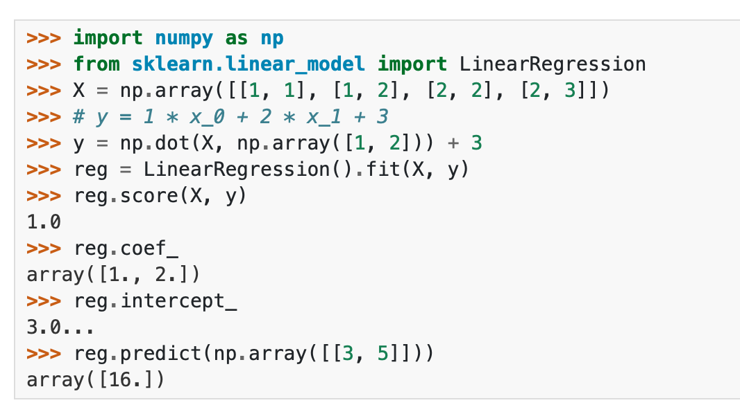
Linear regression in Python
Source: scikit-learn

Slide 27

Logistic regression
We can generalise linear regression to the (binary) classification setting by making some changes.
We compute a linear combination of the inputs, as before, but then we pass this through a function that ensures 0 ≤ μ(x) ≤ 1 by defining:

Slide 28
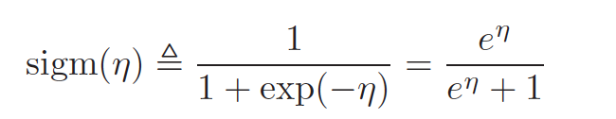
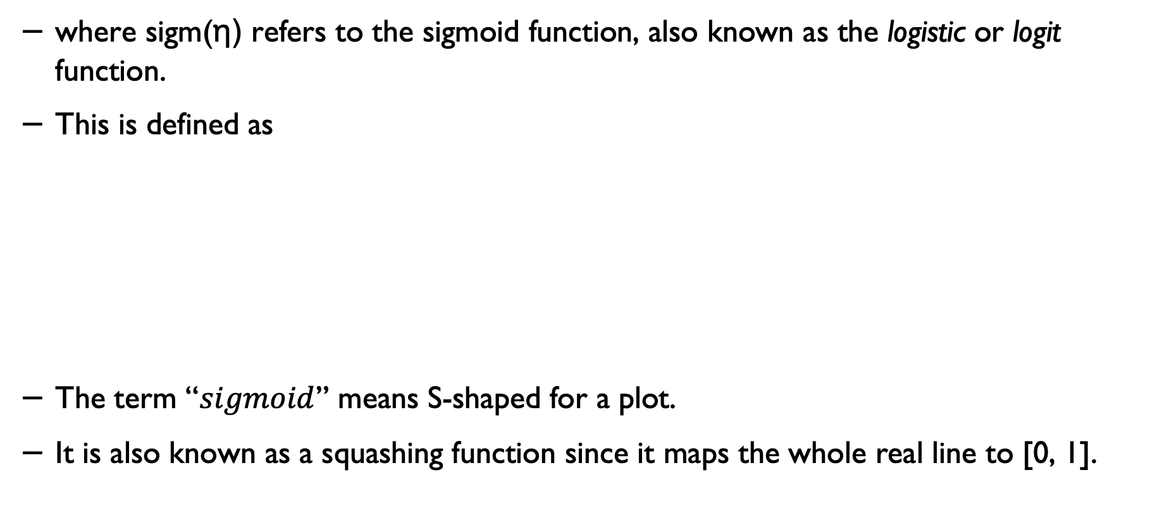
The Sigmoid function
where sigm(η) refers to the sigmoid function, also known as the logistic or logit function.
This is defined as
The term “$sigmoid$” means S-shaped for a plot.
It is also known as a squashing function since it maps the whole real line to [0, 1].

Slide 29
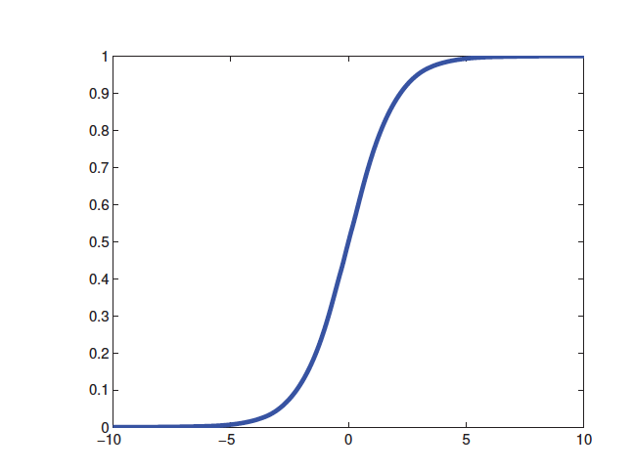
Logistic regression
The process of applying a linear combination of the inputs, as before, but then we pass this through a logistics function, is called logistic regression due to its similarity to linear regression (although it is a form of classification, not regression!).

Slide 30
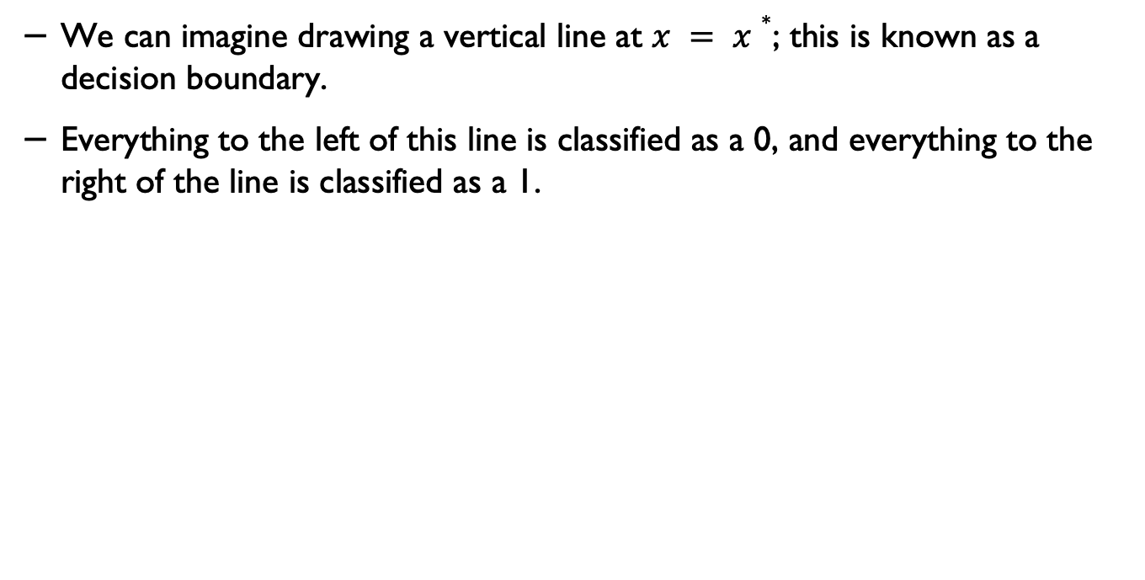
Decision boundary
We can imagine drawing a vertical line at $x = x∗$; this is known as a decision boundary.
Everything to the left of this line is classified as a 0, and everything to the right of the line is classified as a 1.

Slide 31
Decision boundary
This decision rule could have a non-zero error rate even on the training set. This is because the data is not linearly separable, i.e., we can draw no straight line to separate the 0s from the 1s.

Slide 32
Practical methodology
Parametric vs. non-parametric models
Non-parametric models make no assumption on the data distribution or dataset size to generate a model.
The parametric models have a fixed set of parameters (e.g., k-means)
In non-parametric models , the number of parameters grows with the amount of training data.

Slide 33
Parametric vs. non-parametric models
Parametric models have the advantage of often being faster to use, but the disadvantage of making stronger assumptions about the nature of the data distributions.
Nonparametric models are more flexible, but often computationally intractable for large datasets.

Slide 34
K-nearest neighbours
A simple example of a non-parametric classifier is the K nearest neighbour (KNN) classifier.
KNN simply “looks at” the K points in the training set that are nearest to the test input x.
It then counts the number of members of each class in this set and returns the empirical fraction as the estimate.

Slide 35
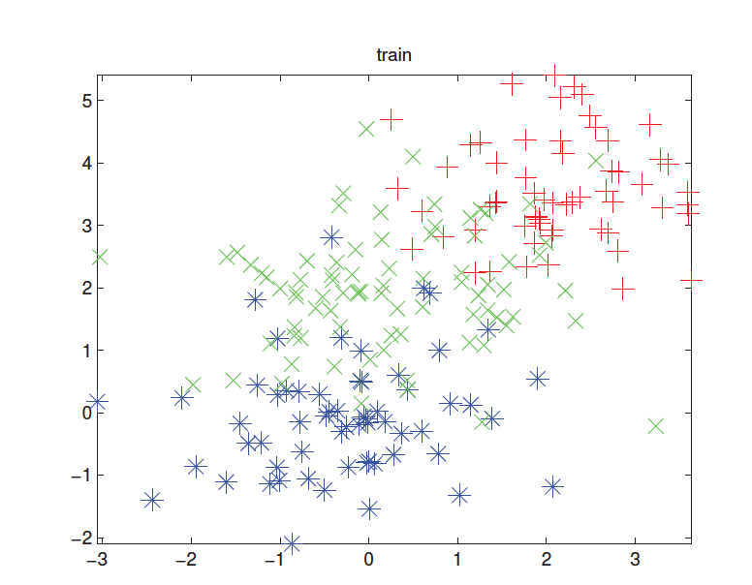
K-nearest neighbours - example

Slide 36
KNN
This method is an example of memory-based learning or instance-based learning.
The most common distance metric to use is Euclidean distance , although other metrics can also be used.

Slide 37
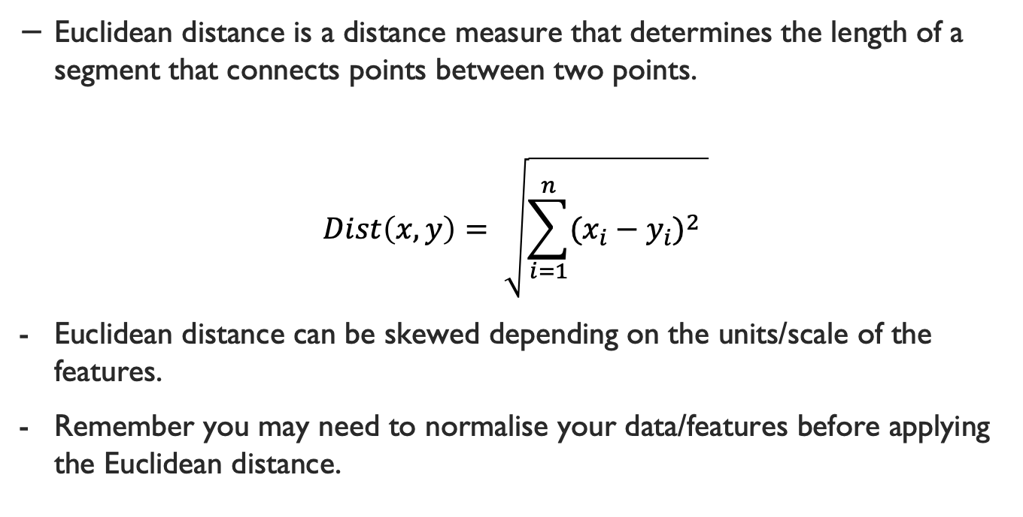
Euclidean distance
Euclidean distance is a distance measure that determines the length of a segment that connects points between two points.
$$Dist\left(x,y\right)= \sqrt{\sum_{i=1}^{n}{{(x_{i}−y_{i})}^{2} }}$$
Euclidean distance can be skewed depending on the units/scale of the features.
Remember you may need to normalise your data/features before applying the Euclidean distance.

Slide 38
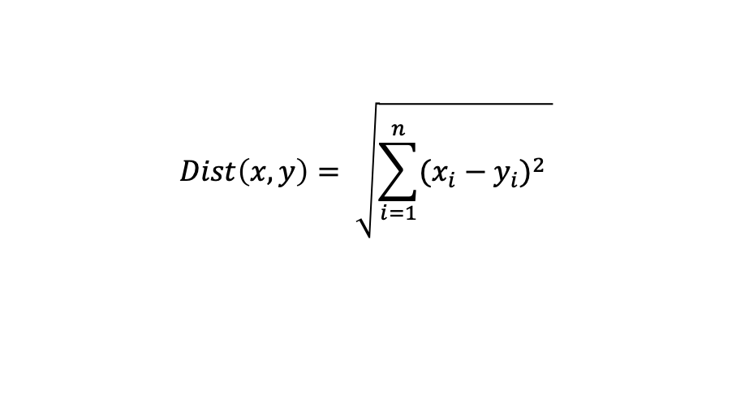
Euclidean distance - example
$$Dist\left(x,y\right)= \sqrt{\sum_{i=1}^{n}{{(x_{i}−y_{i})}^{2} }}$$

Slide 39
The curse of dimensionality
The KNN classifier is simple and can work quite well, provided it is given a good distance metric and has enough labelled training data.
However, the main problem with KNN classifiers is that they do not work well with high-dimensional inputs. The poor performance in high-dimensional settings is due to the curse of dimensionality.

Slide 40
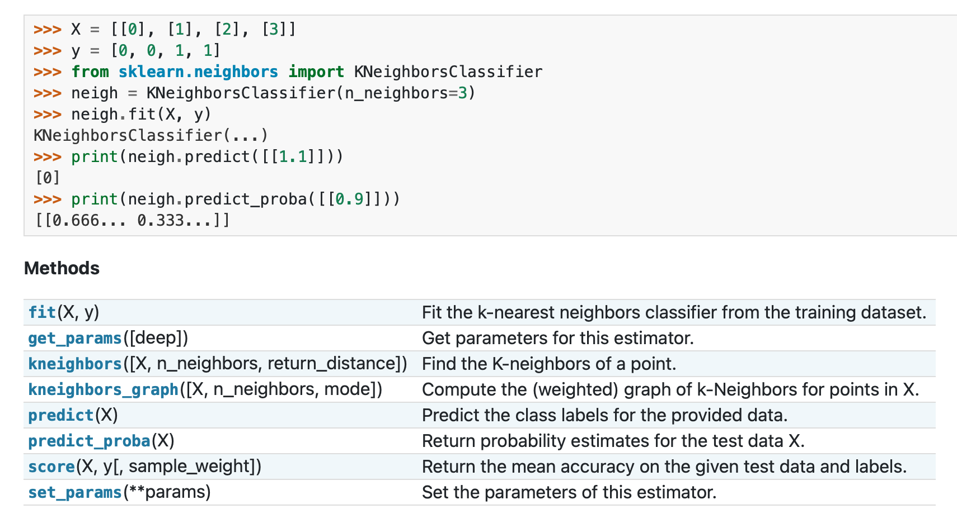
KNN in Python
Source: scikit-learn

Slide 41
Model selection
When we have a variety of models of different complexity (e.g., linear or logistic regression models with different degree polynomials or KNN classifiers with different values of K), how should we pick the right one?

Slide 42
Misclassification rate
A natural approach is to compute the misclassification rate on the training set for each method.
However, what we really care about is generalisation error, which is the expected value of the misclassification rate when averaged over future data.
This can be approximated by computing the misclassification rate on a large independent test set, not used during model training.

Slide 43
Model selection - revisited
When training the model, we don’t have access to the test set (by assumption), so we cannot use the test set to pick the model of the right complexity.
However, we can create a test set by partitioning the training set into two parts: the part used for training the model and the second part, called the validation set, used for selecting the model complexity.
We then fit all the models on the training set, and evaluate their performance on the validation set, and pick the best model/paramters.
Once we have picked the best model, we can refit it to all the available data. If we have a separate test set, we can evaluate performance on this, to estimate the performance of our method.

Slide 44
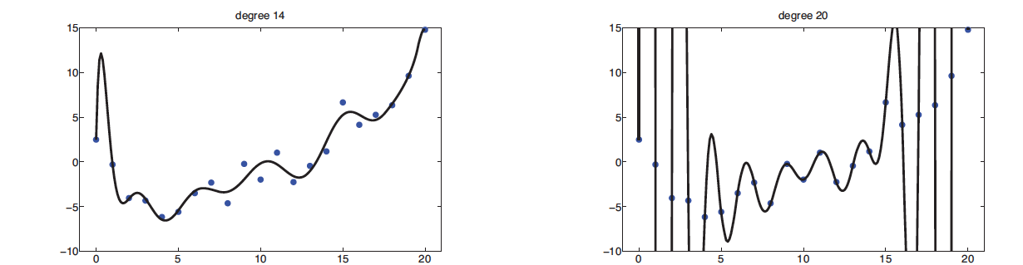
Overfitting
When we fit highly flexible models, we need to be careful not to overfit the data; that is, we should avoid trying to model every minor variation in the input since this is more likely to be noise than true signal.
This is illustrated in the figure above, where we see that using a high-degree polynomial results in a very “wiggly” curve. It is unlikely that the true function has such extreme oscillations.
Using such a model may result in in accurate predictions of future outputs.

Slide 45
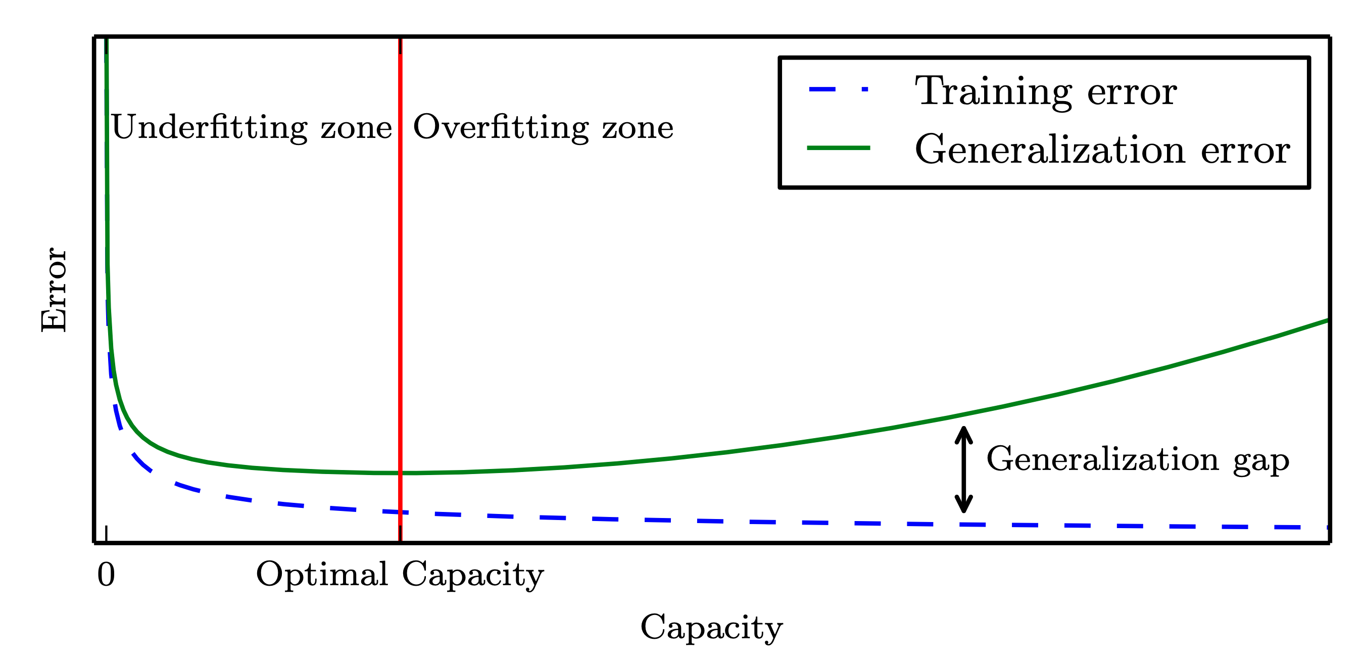
Training and test errors
Source: Deep Learning, Ian Goodfellow et al., MIT press.

Slide 46
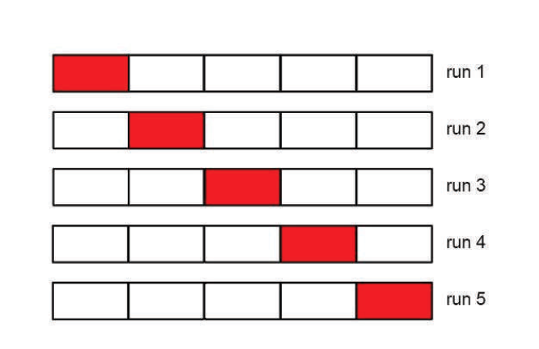
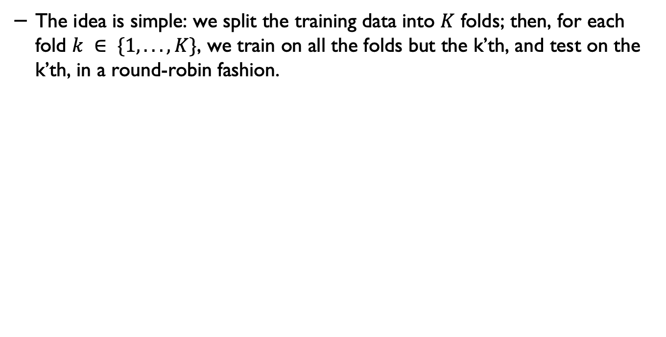
Cross-validation
The idea is simple: we split the training data into $K$ folds; then, for each fold $k ∈ \{1, . . . , K\}$, we train on all the folds but the k’th, and test on the k’th, in a round-robin fashion.

Slide 47
N-Fold cross validation
We then compute the error averaged over all the folds and use this as a proxy for the test error.
Note that each point gets predicted only once, although it will be used for training K−1 times.
It is common to use K = 5 or 10; this is called 5 or 10-fold CV.
If we set K = N, then we get a method called leave-one-out cross-validation, or LOOCV, since in fold i, we train on all the data cases except for i and then test on i.

Slide 48
Cross validation and model selection
Choosing K for a KNN classifier is a special case of a more general problem known as model selection, where we have to choose between models with different degrees of flexibility.
Cross-validation is widely used for solving such problems, although there are other methods/approaches (more on this topic later).

Slide 49
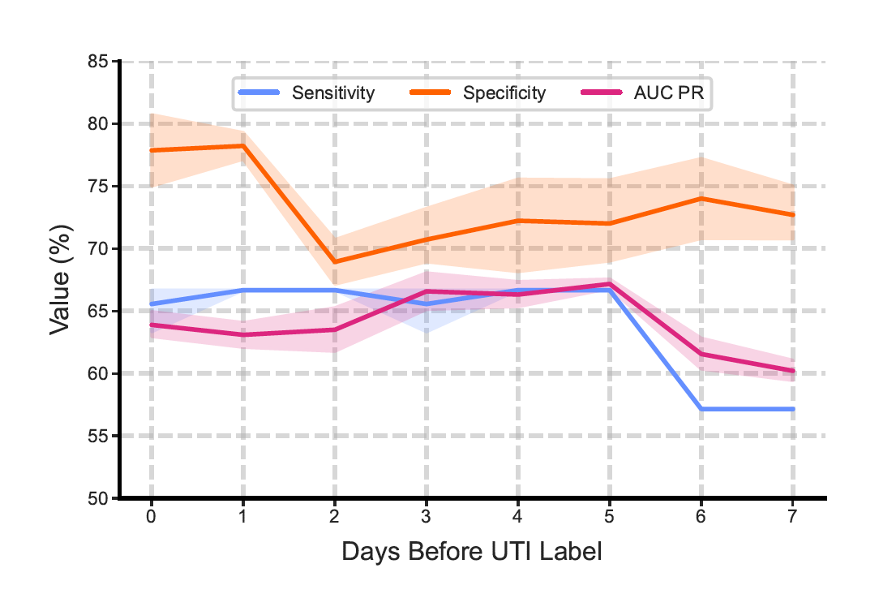
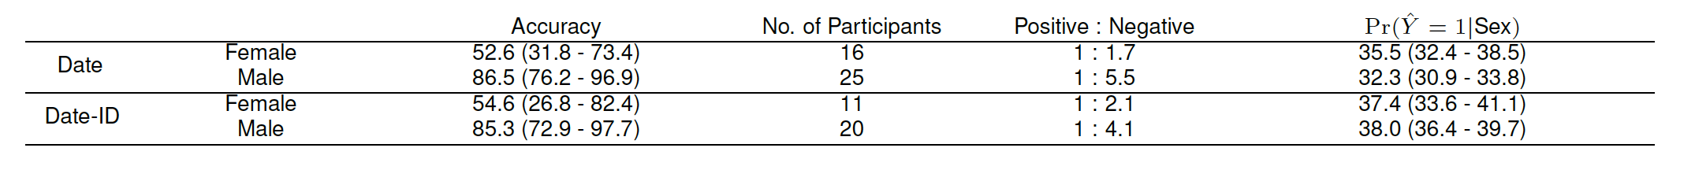
Reporting the results
A. Capstick et al., NPJ Digital Medicine, 2023.

Slide 50
No free lunch theorem
All models are wrong, but some models are useful. — George Box (Box and Draper 1987).
Much of machine learning is concerned with devising different models, and different algorithms to fit them.
We can use methods such as cross-validation to choose the best method for our problem empirically.
However, there is no universally best model — this is sometimes called the no free lunch theorem (Wolpert 1996).
The reason for this is that a set of assumptions that work well in one domain may work poorly in another.

Slide 51
Different models for different problems
We need to develop many different types of models to cover the wide variety of data that occurs in the real world.
And for each model, there may be many different methods that we can use to train the model, which makes different speed-accuracy-complexity trade-offs.
More on this next week.

Slide 52
Review questions
Source: The questions are adapted from “Deep Learning Interviews”, Shlomo Kashani.

Slide 53
Q1
True or False: A non-parametric model has no parameter to train?

Slide 54
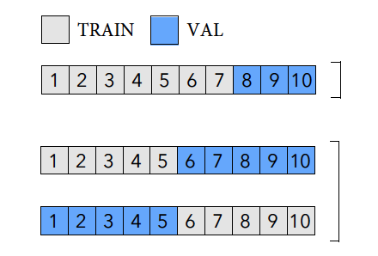
Q2
The figure depicts two different cross-validation approaches. Which one is a k-fold cross validation?
(a)
(b)

Slide 55
Q3
Sigmoid function is a nonlinear function, Ture or False?

Slide 56
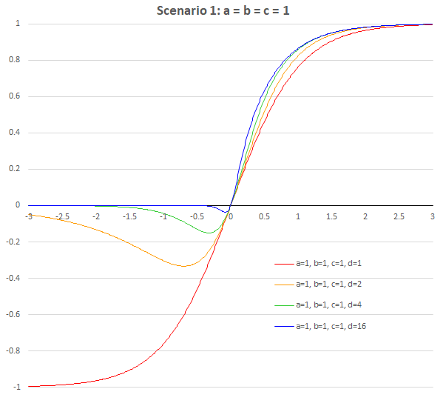


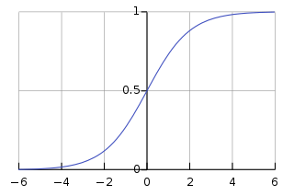
Q4
Which of these show the output of a sigmoid function?
(b)
(a)
(c)
(d)
Image sources: Wikipedia

Slide 57
Acknowledgement
Some of the slides in this lecture are adapted from Kevin Murphy’s and Tibshirani et al.’s book:
Machine Learning: A Probabilistic Perspective Kevin P. Murphy, MIT Press.
Tibshirani et al.: An introduction to statistical learning: https://www.statlearning.com

Slide 58
Additional slides (optional further reading)
In the linear regression section, we discussed different metrics to minimise the error. There are also methods that control the weights (coefficients) and try to find optimised values/sets of coefficients/weights that can be used in a regression model. Lasso and Ridge are two of these techniques. The next few slides discuss them briefly.

Slide 59
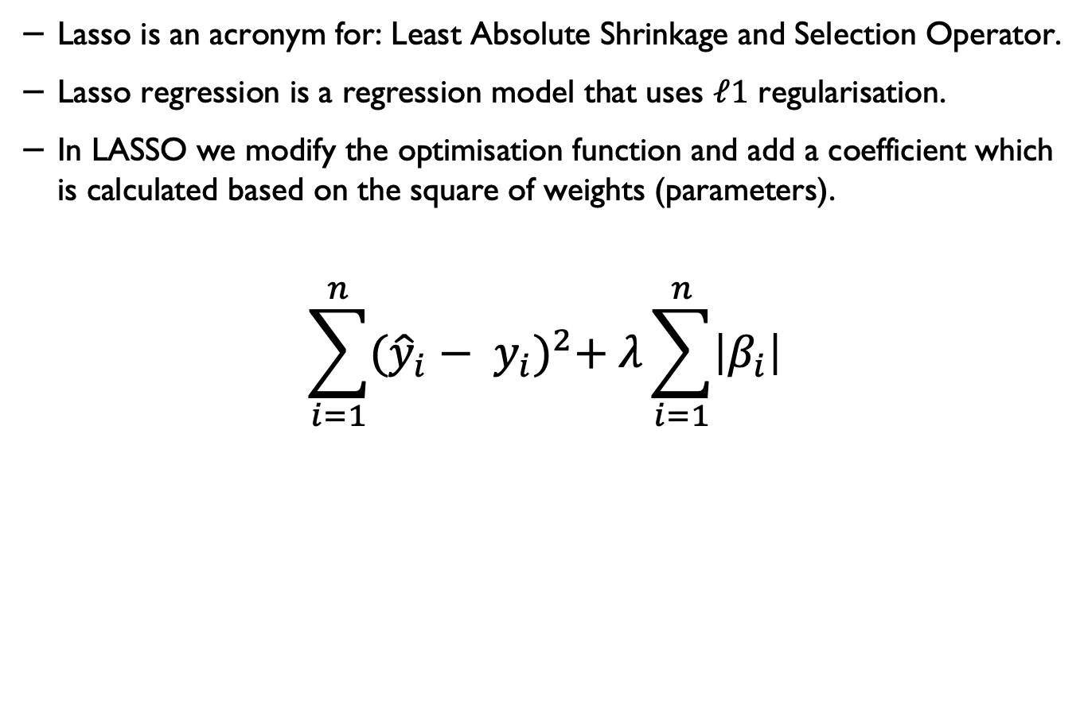
L1 Regularisation (Lasso)*
Lasso is an acronym for: Least Absolute Shrinkage and Selection Operator.
Lasso regression is a regression model that uses $ℓ1$ regularisation.
In LASSO we modify the optimisation function and add a coefficient which is calculated based on the square of weights (parameters).
$$\sum_{i=1}^{n}{{({\hat{y}}_{i}− y_{i})}^{2}+ λ\sum_{i=1}^{n}{\left|β_{i}\right|}}$$

Slide 60
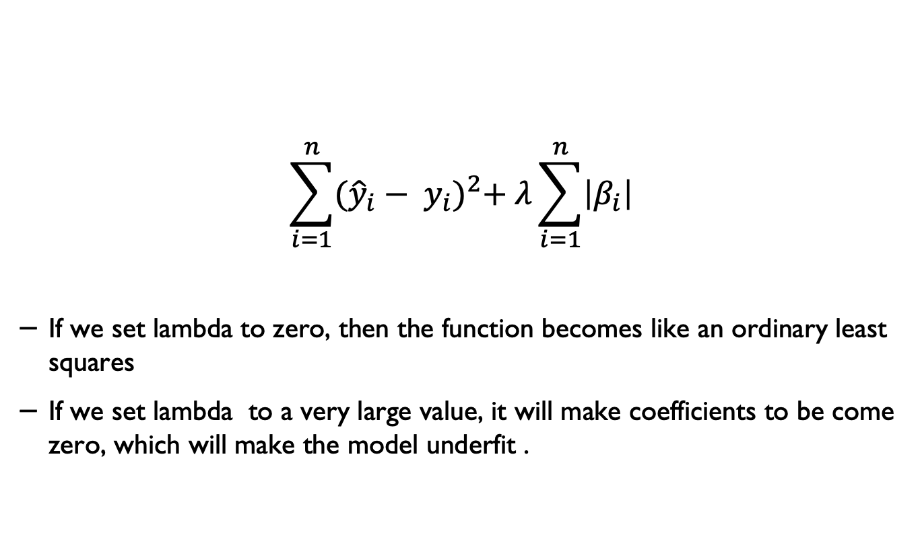
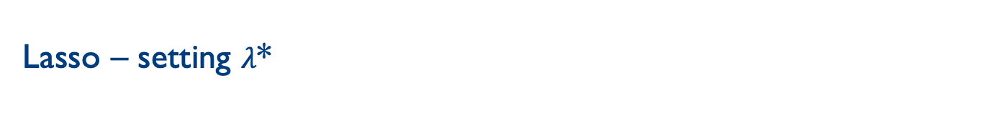
Lasso – setting $λ$*
$$\sum_{i=1}^{n}{{({\hat{y}}_{i}− y_{i})}^{2}+ λ\sum_{i=1}^{n}{\left|β_{i}\right|}}$$
If we set lambda to zero, then the function becomes like an ordinary least squares
If we set lambda to a very large value, it will make coefficients to be come zero, which will make the model underfit .
Source: Anuja Nagpal, https://builtin.com/data-science/l2-regularization

Slide 61
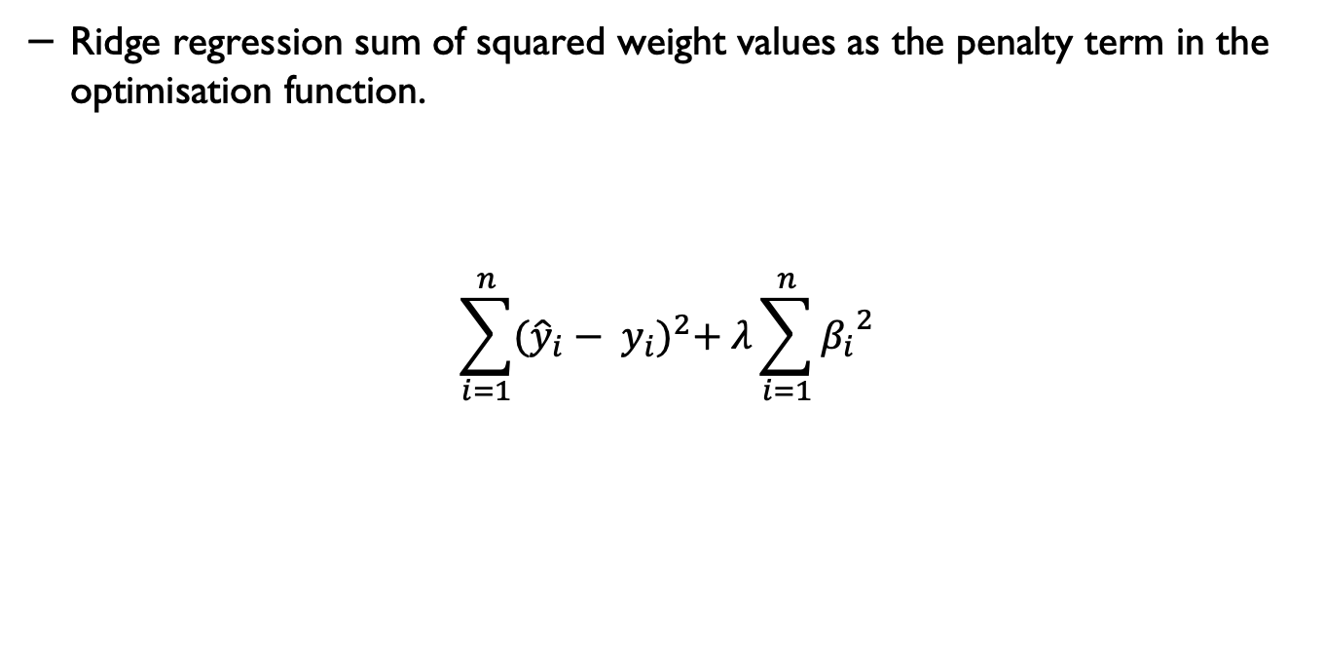
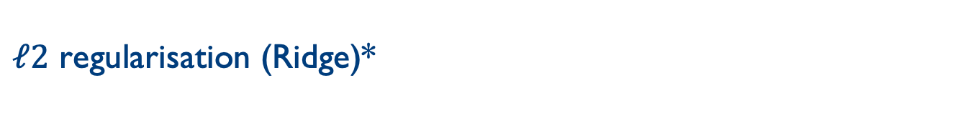
$ℓ2$ regularisation (Ridge)*
Ridge regression sum of squared weight values as the penalty term in the optimisation function.
$$\sum_{i=1}^{n}{{({\hat{y}}_{i}− y_{i})}^{2}+ λ\sum_{i=1}^{n}{{β_{i}}^{2}}}$$

Slide 62
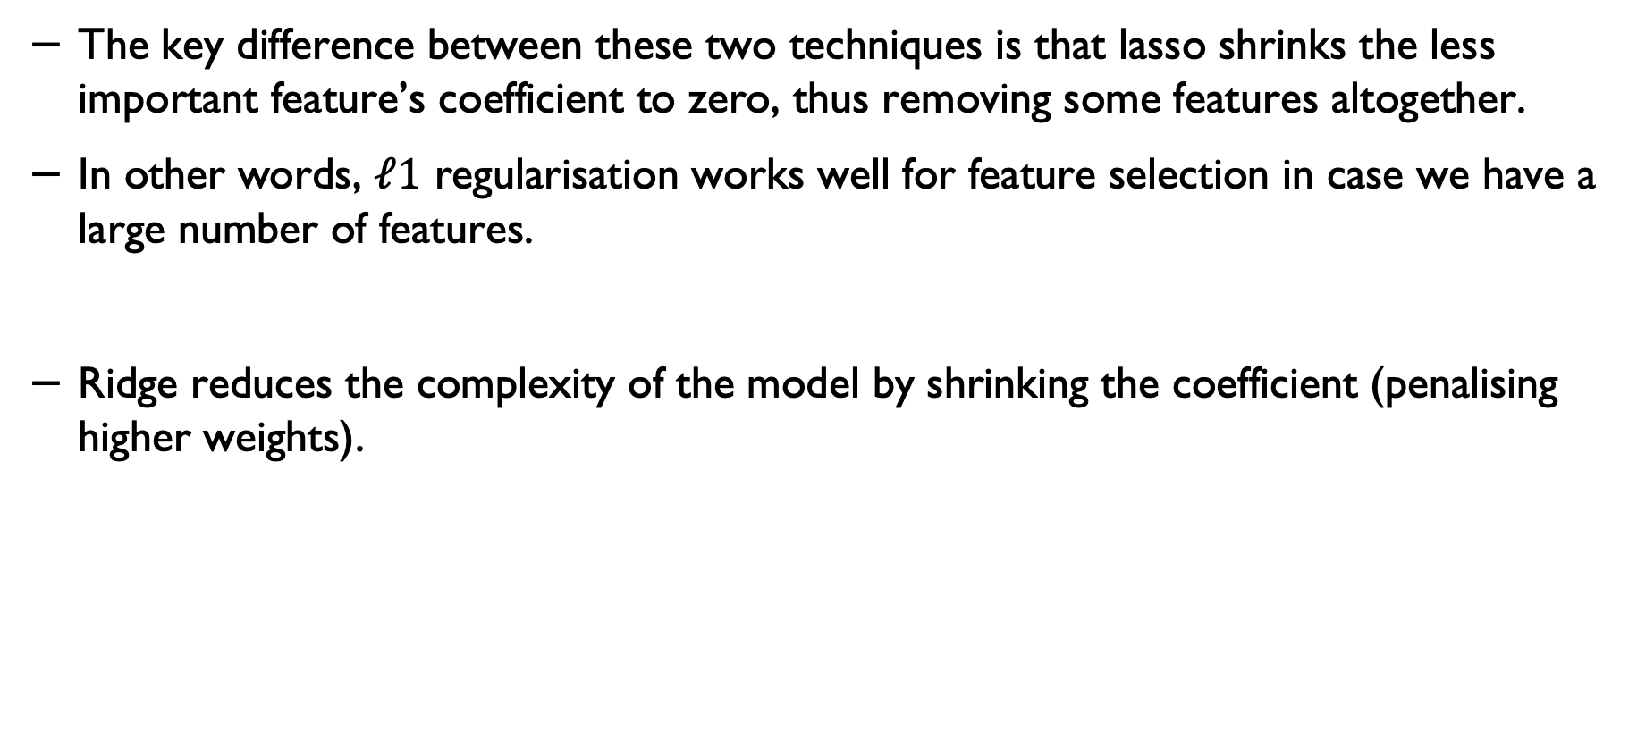
Lasso and Ridge
The key difference between these two techniques is that lasso shrinks the less important feature’s coefficient to zero, thus removing some features altogether.
In other words, $ℓ1$ regularisation works well for feature selection in case we have a large number of features.
Ridge reduces the complexity of the model by shrinking the coefficient (penalising higher weights).

Slide 63
If you have any questions
Please feel free to arrange a meeting or email (p.barnaghi@imperial.ac.uk).
My office: 928, Sir Michael Uren Research Hub, White City Campus.

